Slide 1
Autograder Frontend
CSCE 606
Fall 2024

Slide 2
Autograder Frontend
Developed using Ruby on Rails and Agile Methodology
Team Members:
Mainak Sarkar (masarkar@tamu.edu)
Max Smith (maxsmith271346@tamu.edu)
Md Hasan AI Banna (mdhasanalbanna@tamu.edu)
Riddhi Ghate (riddhighate.07@tamu.edu)
Ryan Gonzalez (gonzalezpear@tamu.edu)
Saksham Mehta (saksham19@tamu.edu)
Qinyao Hou (yaoya2618@tamu.edu)

Slide 3
Introduction to the Project
Overview
The CSCE 120 Autograder Frontend is a user-friendly application designed to streamline the creation and maintenance of autograded assignments. It provides an accessible graphical interface for generating assignment GitHub repositories, interactively creating tests, and managing user permissions.
Target Audience
Course Instructors and Teaching Assistants
Purpose
The application aims to:
Simplify the assignment creation and constituent test management.
Enable rapid development and testing of assignments.
Ensure accessible and efficient management of autograding workflows.

Slide 4
Problem Statement and Solution
Problem:
Managing assignments and tests for CSCE 120 is time-consuming and complex.
Existing processes lack a user-friendly interface for creating and maintaining autograded assignments.
There is no streamlined process for editing, creating, or deleting tests within an assignment.
Solution:
Provides a user-friendly frontend to simplify the creation and maintenance of assignments and tests.
Streamlines and simplifies the process for editing, creating, or deleting tests within an assignment.
Offers robust permission management for assigning read/write access to users in the organization.

Slide 5
UI Overview
Screenshots of the Application Interface:
The next 4 slides are screenshots of the autograding system's user interface, showing key components and their functionality.

Slide 6
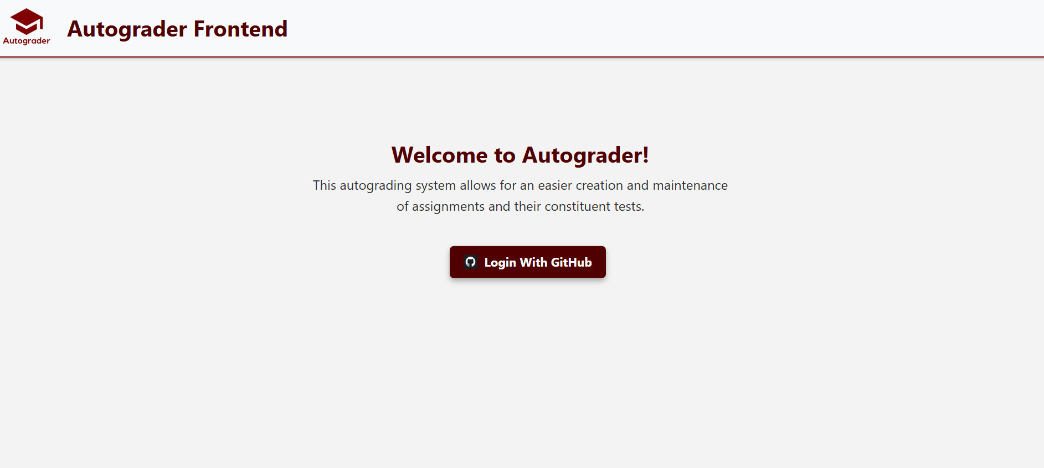
Login Page:
Secure login via GitHub for authenticated access.

Slide 7
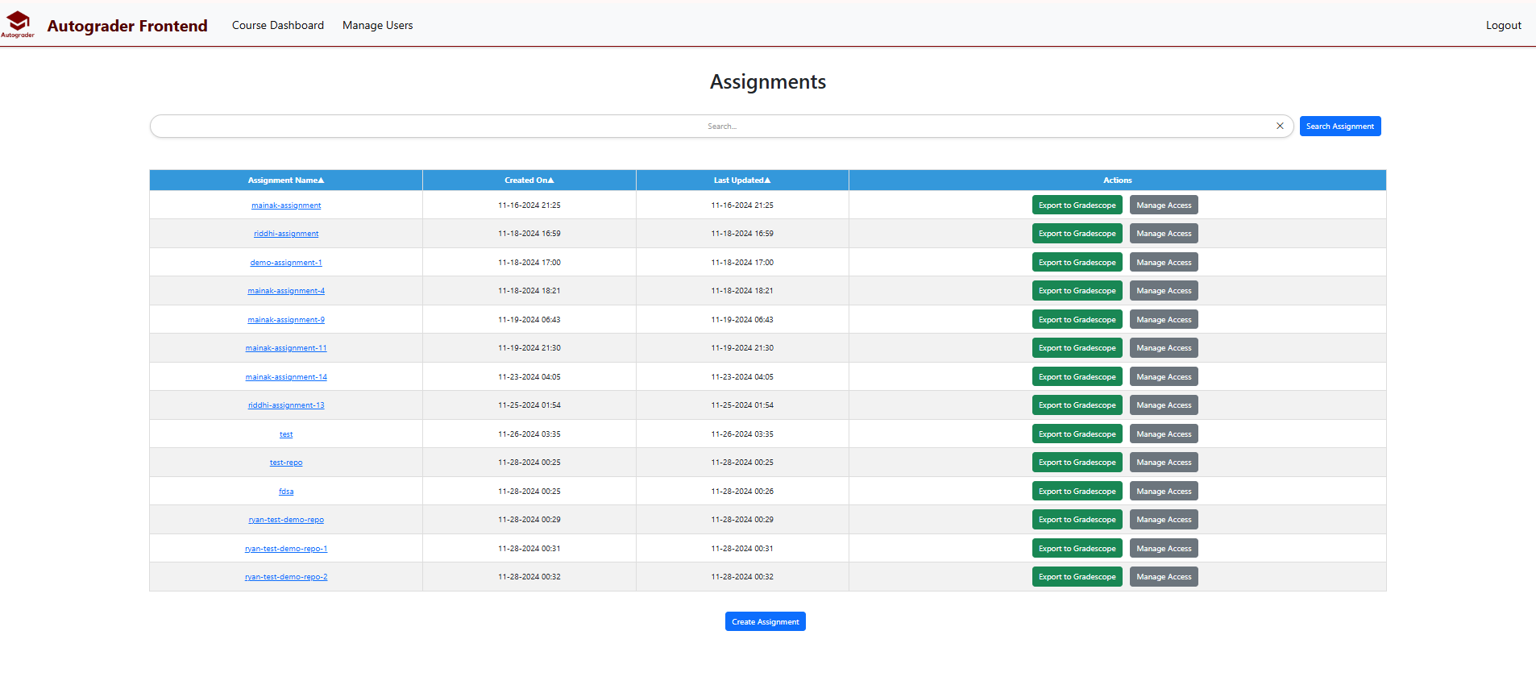
Dashboard:
Central hub for managing assignments, with sortable tables and filters

Slide 8
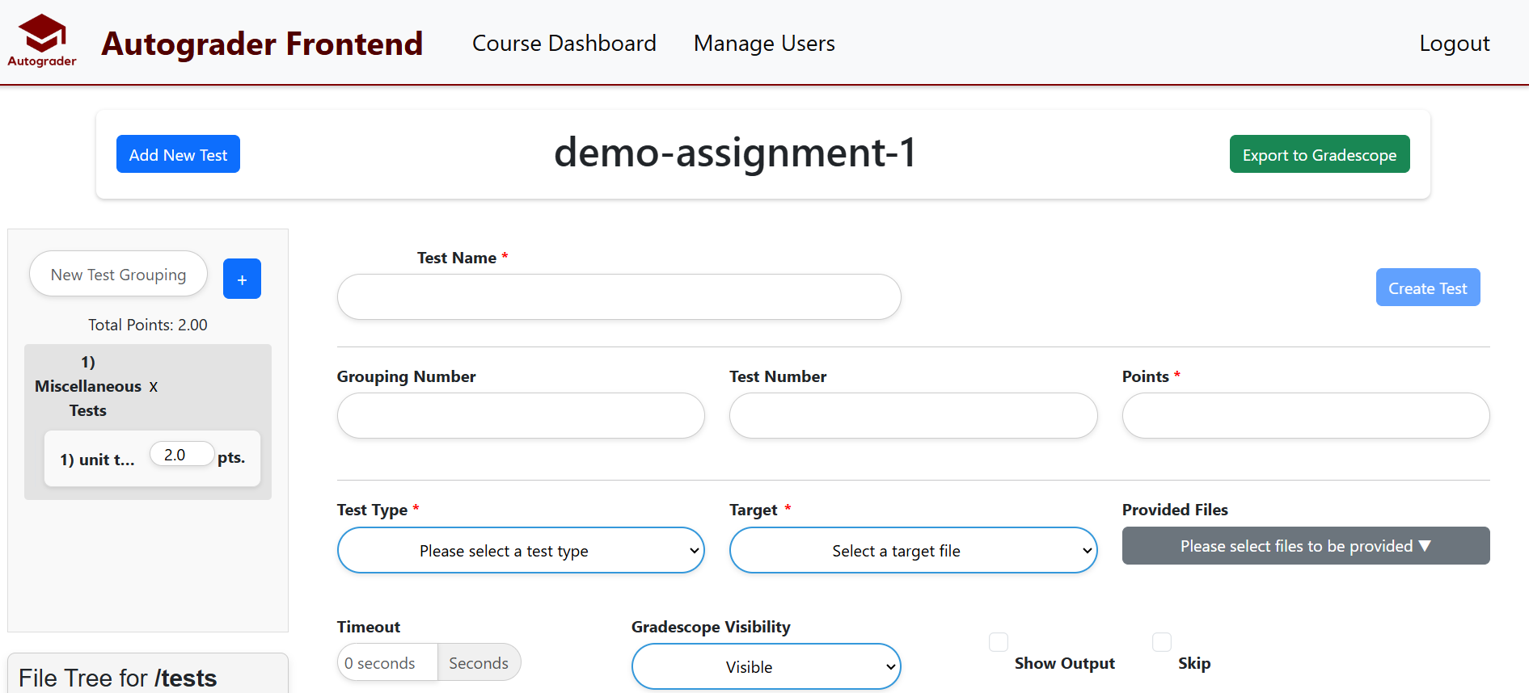
Assignment Management:
Interface for creating, editing, and managing tests for each assignment

Slide 9
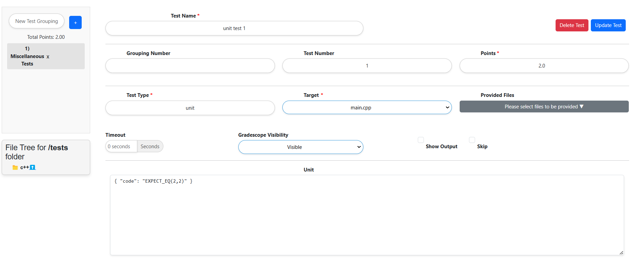
Test Case Management:
Simple, intuitive interface for adding, editing, or deleting tests within assignments.

Slide 10
Key Features
User Authentication
Description: Users can log in securely via GitHub, ensuring that only authorized personnel (instructors and TAs) can access the system.
Benefit: Simplifies access control with third-party authentication.
Dashboard Navigation
Description: The dashboard displays all assignments in an organized, sortable table with the ability to filter by name, date, or status.
Benefit: Provides quick and easy access to all assignments for instructors and TAs.

Slide 11
Key Features…
Manage User Access
Description: Admins can manage user permissions for each assignment, adjusting read/write access as needed.
Benefit: Fine-grained control over who can view or modify assignments.
Assignment Creation and Permissions
Description: New assignments can be created by filling out a simple form, which then automatically generates a GitHub repository under the CSCE 120 organization.
Benefit: Streamlines the process of creating and assigning assignments, with adjustable permissions for TAs and instructors.

Slide 12
Key Features...
Test Case Management
Description: Create and manage test cases for each assignment, with dynamic fields that change based on test type.
Benefit: Simplifies the process of adding and editing tests, ensuring that tests align with assignment requirements.
Editing and Deleting Tests
Description: Tests can be easily edited or deleted with confirmation prompts to ensure updates are managed safely.
Benefit: Provides flexibility in managing test cases throughout the course.

Slide 13
Key Features…
Test Grouping and Point Updates
Description: Group tests together and adjust points in real-time. Points for test groupings are dynamically updated as changes are made.
Benefit: Organizes tests effectively and ensures accurate scoring.
Drag-and-Drop Functionality
Description: Tests can be rearranged between test groupings using intuitive drag-and-drop functionality.
Benefit: Simplifies test organization, making it more flexible and user-friendly.

Slide 14
Key Features…
File Management
Description: Files can be uploaded directly to the assignment repository, with an easy-to-use file tree for managing file selections for tests.
Benefit: Ensures that required files for testing are accessible and properly linked to test cases.
Responsive User Interface
Description: The application is designed with a responsive layout that adapts to different devices and screen sizes.
Benefit: Ensures that users have a consistent experience on any device, whether desktop, tablet, or mobile.

Slide 15
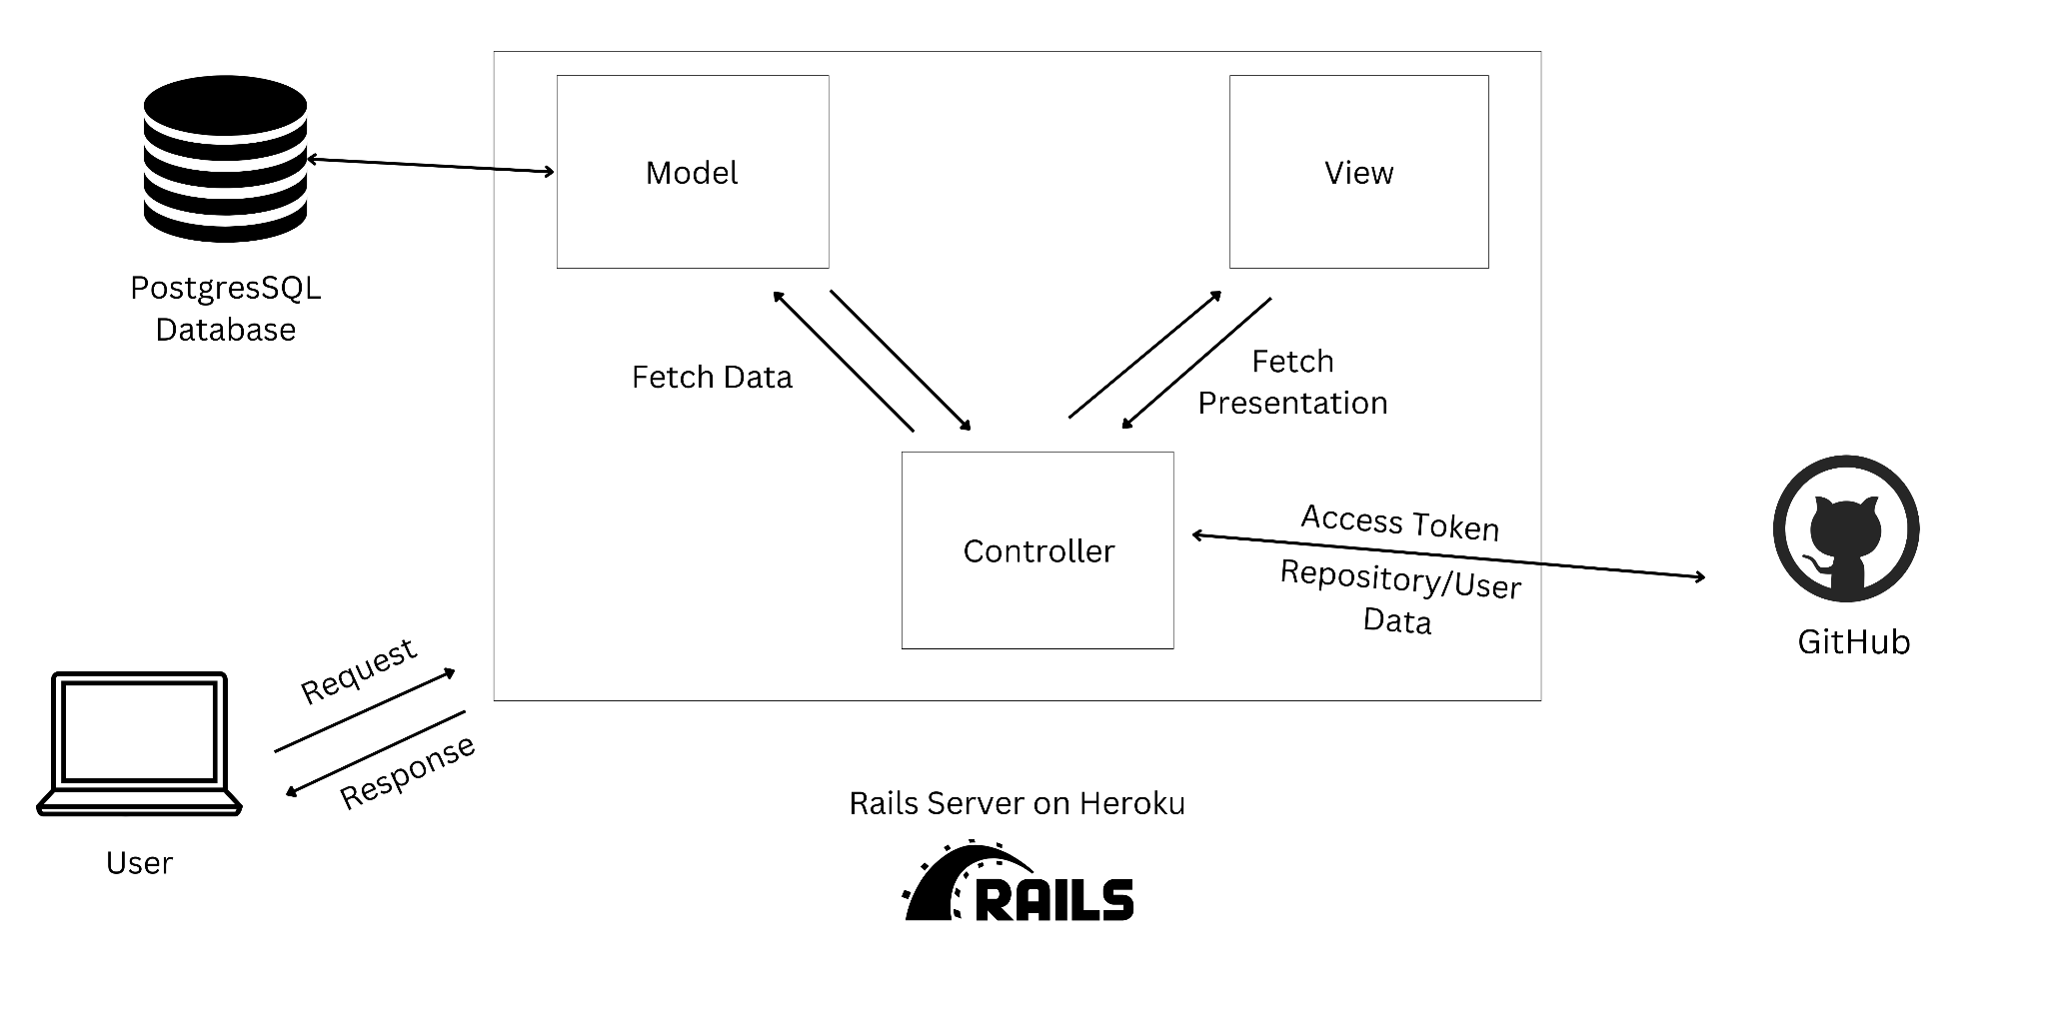
Design

Slide 16
Challenges
Underestimation of complexity
User stories were often underestimated, leading to last-minute crunches.
Dependencies between user stories caused issues with prioritization and execution.
Merge Conflicts and Dependency Management
Lack of a priority/order for user stories resulted in complex merge conflicts.
Dependencies between tasks were not accounted for during planning.
Inconsistent Practices
Adherence to Git best practices was inconsistent, causing workflow inefficiencies.
Environment Disparities
Differences between test and production environments led to deployment issues.
Ineffective Communication
Initially, the team struggled with communication, leading to confusion and delays.

Slide 17
Lessons Learned
Prioritize Effective Communication:
Communication and collaboration improved over the course of the project, emphasizing the need for open discussions and knowledge sharing.
Plan with Dependencies and Complexity in Mind:
Assessing story complexity more realistically and accounting for dependencies is crucial to smooth execution.
Assigning priorities and sequencing tasks effectively can prevent bottlenecks.
Improve Environment Consistency:
Using a staging branch or environment is essential for continuous deployment practices.

Slide 18
Lessons Learned
Adhere to Best Practices:
Following Git best practices ensures a streamlined development process.
Effective testing throughout the sprint prevents late-stage surprises.
Focus on Usability and Functionality:
Better wireframes and usability-focused designs contribute to a stronger MVP.
Early emphasis on functionality ensures that client requirements are met effectively.
Boost Accountability and Task Management:
Breaking down tasks into smaller, manageable subtasks improves task clarity and completion.

Slide 19
Future Scope
Ability to resolve merge conflicts
Add/Remove Github user from organization
Pull remote changes from Github
Parse tests coming in from remote
Add an administrator role

Slide 20
Thank You!

